Slide 2

Weather Data Analysis
Trieu Kinh Quoc | 20225524
Vu Quoc Dung | 20225488
Phung Tien Thanh | 20225531
Tran Khoi Nguyen | 20225453
Le Minh Hai | 20225491

Slide 3
Table of contents
1. Topic + general pipeline
2. Deployment strategy
3. Details component
4. Lesson learned
5. Live Demo

Slide 4
1. Topic + Pipeline
Purpose:
Collect real-time weather data, store, process, and analyze the data to detect trends, perform short-term forecasting, and enable data visualization.
Properties:
Data source: Weather API from OpenWeatherMap
Type: Semi-structured data (JSON)
Contents: Major weather attributes
City information: City name, country codes (of the city), date-time (the specific date-time when the data is fetched)
Temperature, humidity, wind speed and direction, precipitation, cloud cover and visibility, atmospheric pressure, and rain volume
Taken from Cities: 20 major global cities around the world
Ingestion rate: Data is fetched and streamed every 10 seconds

Slide 5
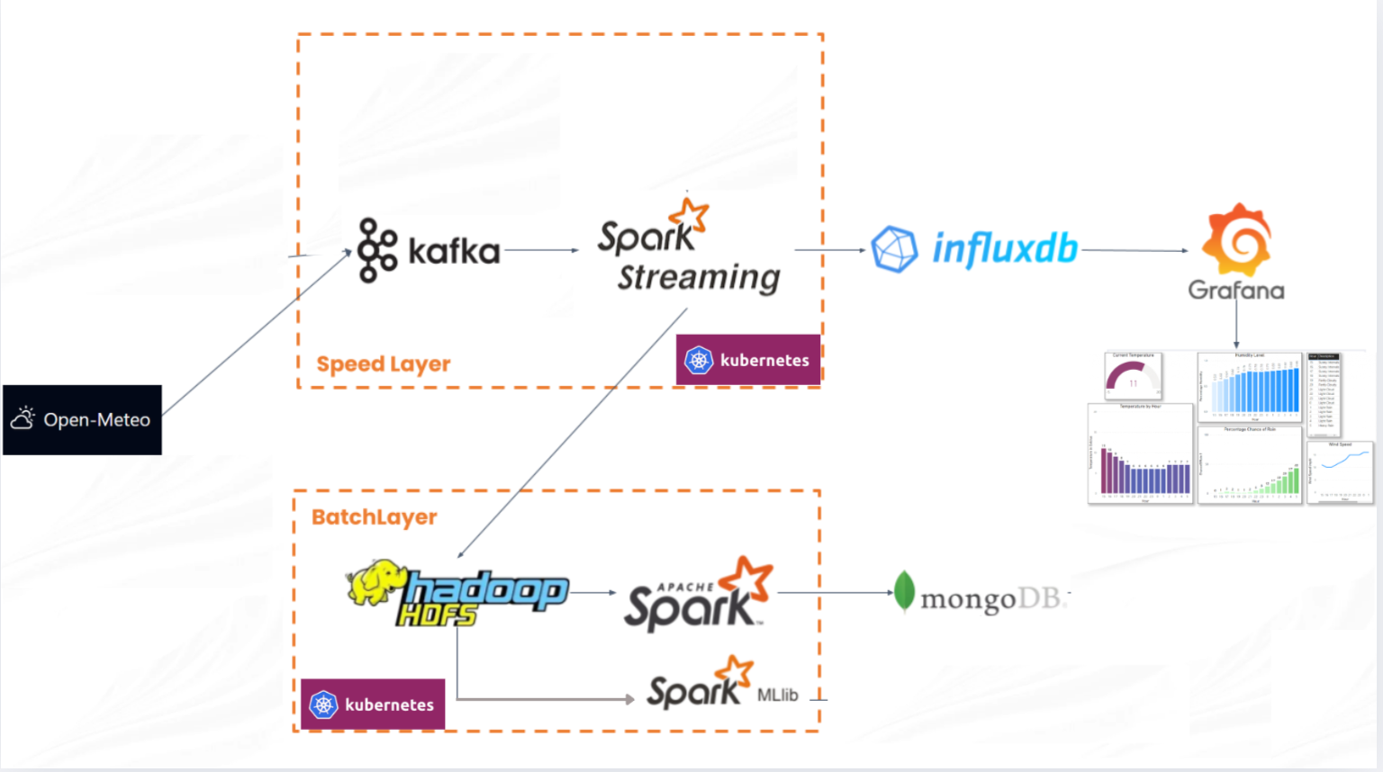
1. Topic + Pipeline

Slide 6
2. Deployment phase
Include 3 phases:
Phase 1 - Planning and Data Acquisition: Defined architecture, developed Python scripts to ensure stable data fetching.
Phase 2 - Docker Compose: Deployed the end-to-end pipeline in Docker to verify component connectivity (networking, volumes) in a more simplified environment.
Phase 3 - Kubernetes Migration:
Converted pipeline to K8s environment.
Deployed StatefulSets for stateful components (HDFS, InfluxDB, Mongo).
Deployed Deployments for stateless compute (Spark jobs).
Deployed a simple Linear Regression model using collected data.

Slide 7
3. Detailed components
Kafka implementation:
Ran in Kraft mode, removing Zookeeper dependency, which simplifies cluster management. The Kafka cluster contains:
1 controller pod: Manage the overall Kafka cluster
3 brokers pods: Store and streaming the data from producer.py.
Data is replicated through 3 brokers to ensure fault tolerance.
Script producer.py: taking data from OpenWeather API to Kafka

Slide 8
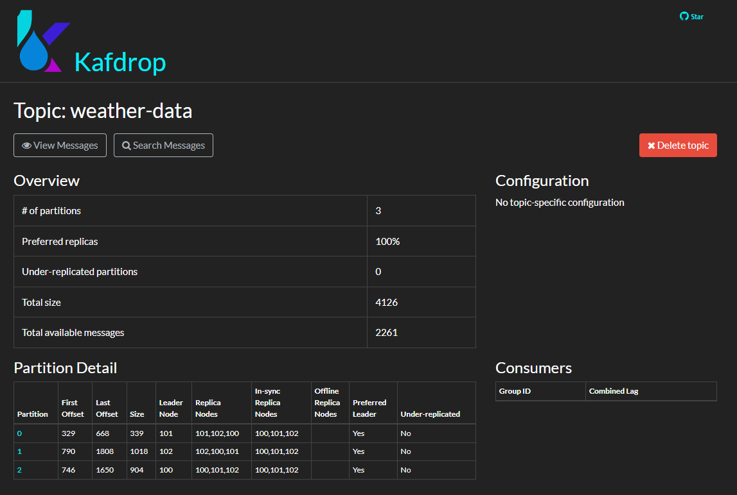

Slide 9
3. Detailed components
Spark implementation:
Spark-streaming-consumer Deployment (Speed layer): Real-time processing (consuming weather data from Kafka topic).
Write data from Kafka to:
InfluxDB: Immediate write for real-time dashboards and monitoring.
HDFS: Persistence of raw data in parquet format for long-term storage.
Produce real-time log for easier management.

Slide 10
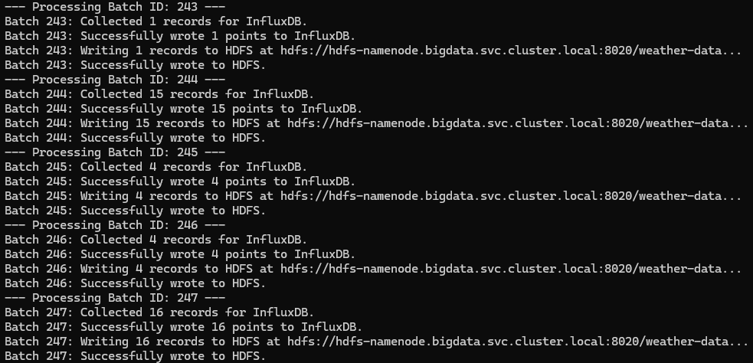

Slide 11
3. Detailed components
Spark implementation:
Spark-batch Deployment (Batch layer): Responsible for data refinement and aggregation (write the de-duplicated + aggregated data from HDFS to MongoDB).
Is scheduled to execute every 3 hours.
Provide two batch views:
daily_summary: daily weather summary for each city.
city_summary: all-time weather summary for each city.
Write batch views to MongoDB.

Slide 12
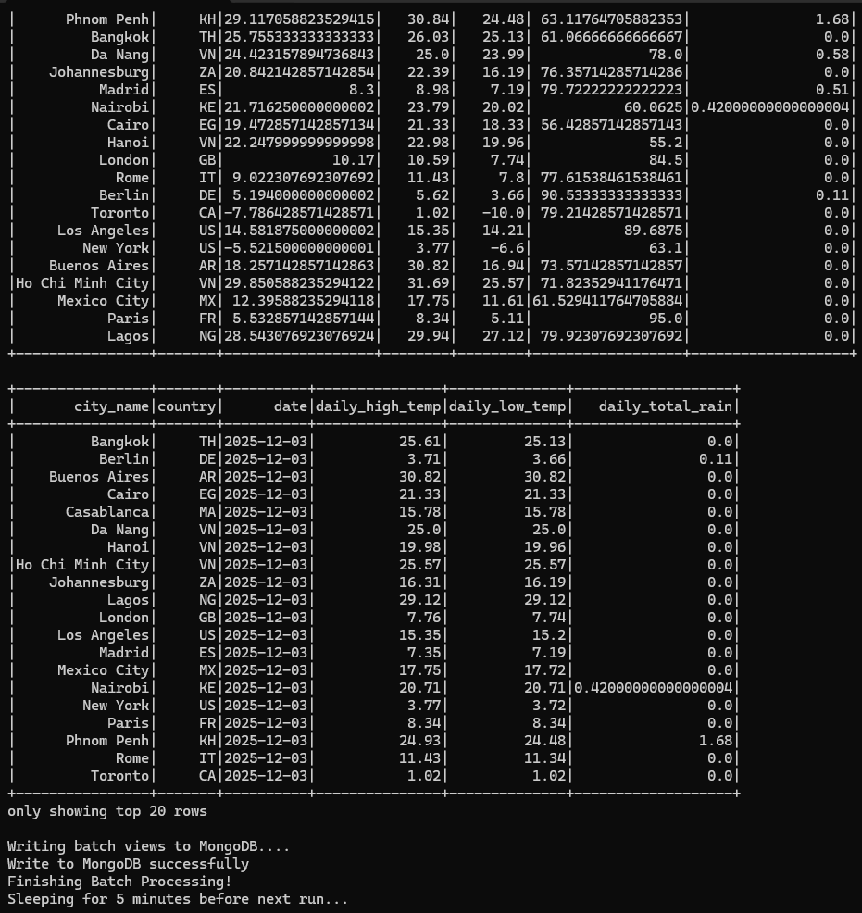
Spark Batch log

Slide 13
3. Detailed components
Extra: Simple Linear Regression with Spark MLlib (Spark Job)
Develop a simple predictive model using linear regression to demonstrate Spark MLlib’s capabilities for predictive forecasting.
Independant variable: Temperature.
Dependant variable: humidity, wind_speed cloud_cover, visibility, air_pressure, air_pressure_sea_level, air_pressure_ground level, wind direction, rain.
Training workflow:
Loads data from HDFS.
Cleans data
Time-based train-test splitting (80/20) and scaling (StandardScaler)
Training
Measures performance via standard metrics (RMSE, R²)
Note: This model is for educational use only and requires further development for notable results.

Slide 14
3. Detailed components
InfluxDB:
Role: Time series database for the Speed Layer
Implemented as a StatefulSet:
5Gi PersistentVolumeClaim (PVC) to prevent data loss during pod restarts.
Configuration:
Secret: Contains API Tokens, username, passwords, …

Slide 15
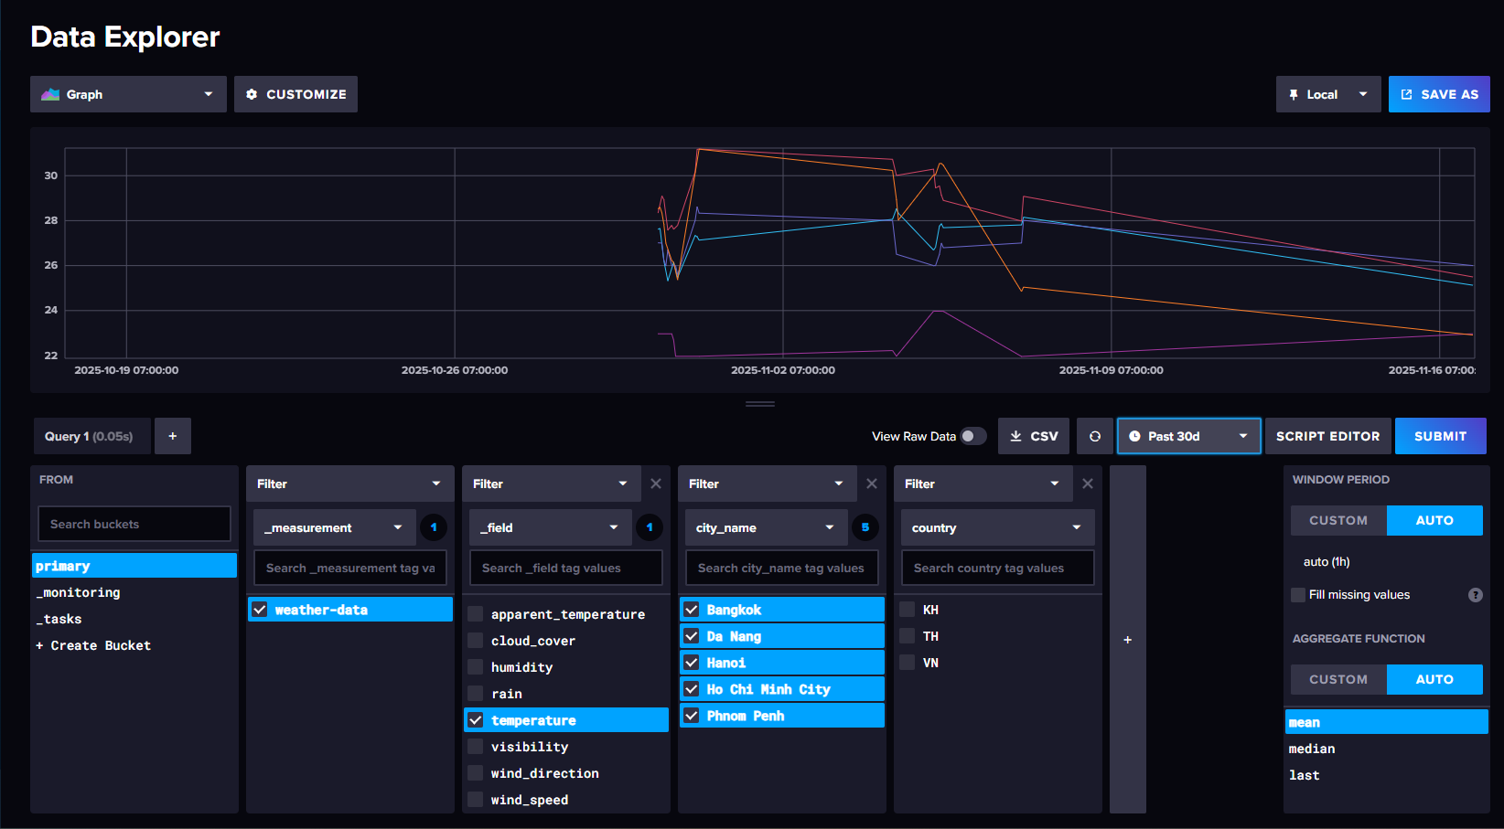

Slide 16
3. Detailed components
Grafana:
Role: Providing real-time data visualization for specific cities.
Implemented as a deployment.
Configuration:
ConfigMap: Configuration link to InfluxDB using internal cluster DNS (http://influxdb.bigdata.svc.cluster.local:8086).
Secret: UI login information (admin username/password)

Slide 17
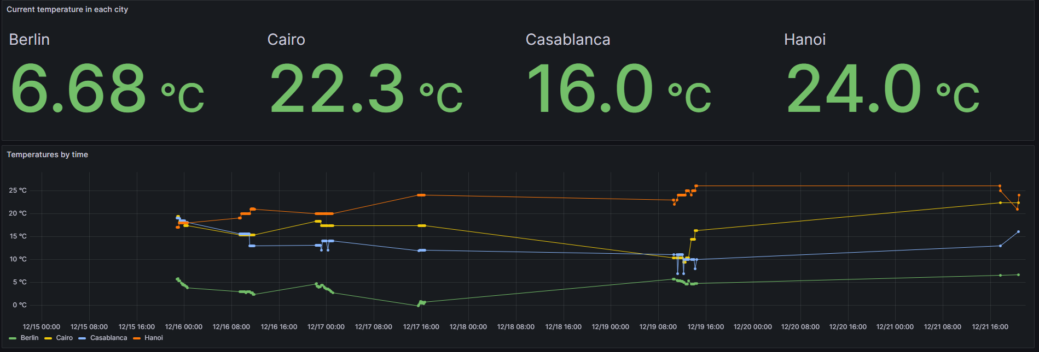

Slide 18
3. Detailed components
HDFS
Role: The primary storage for batch layer, hosting raw .parquet files for historical processing and ML training.
Implemented as Statefulsets:
NameNode (1 replica): Manages metadata and filesystem namespace.
DataNodes (2 replicas): Each node requests a 10GB PVC for physical data blocks.
Data is replicated in two nodes for fault tolerance.

Slide 19
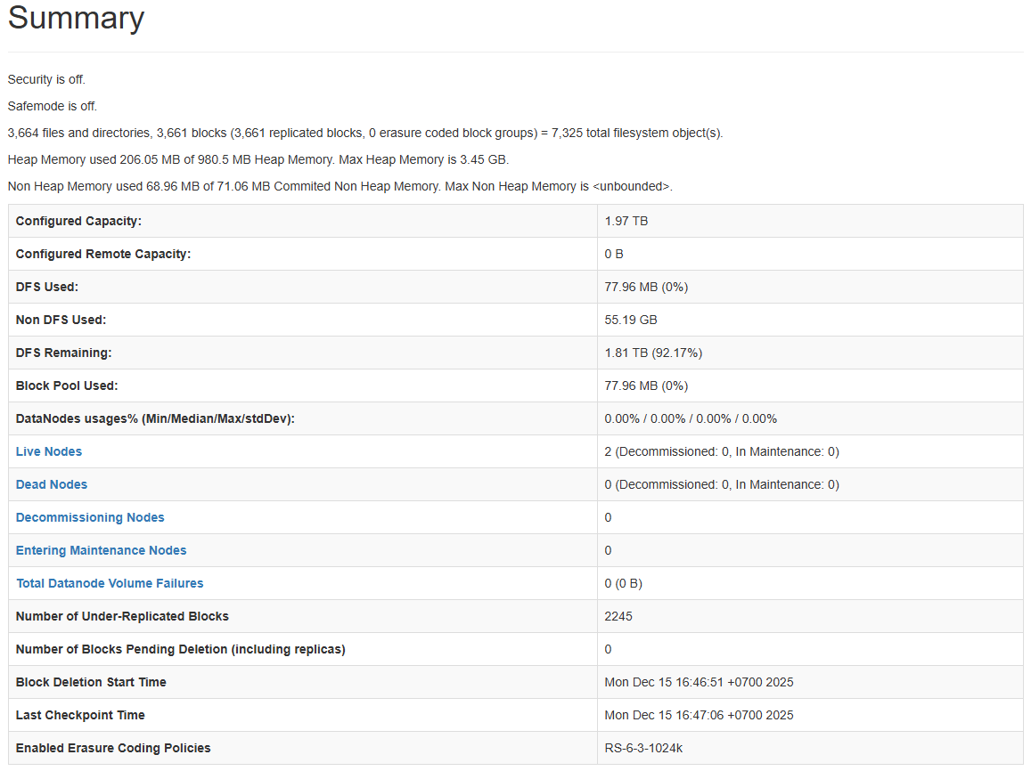
HDFS Namenode UI

Slide 20
3. Detailed components
YARN configuration:
Role: Acts as the cluster manager, responsible for arbitrating resources and scheduling jobs across the Hadoop ecosystem.
YARN is deployed through 2 deployments:
resourcemanager: overall HDFS cluster resource management
nodemanager: resource management for each node in HDFS cluster
YARN is configured with the activated `default` queue and is allocated 100% of the cluster resources for simplification.

Slide 21
3. Detailed components
MongoDB:
Role: Storing structured, pre-calculated aggregated views.
Implemented as a Statefulset:
Bound to a 5Gi PersistentVolumeClaim (PVC) to ensure aggregated insights survive after pod restarts.
Data structure (weather_db):
city_summary: Statistical aggregates for each city (Avg/Min/Max temperature, total rainfall).
daily_summary: Historical daily statistics for each city.

Slide 22
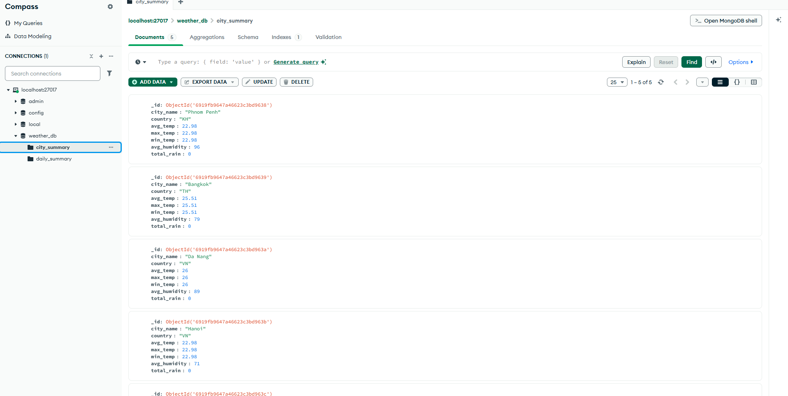

Slide 23
4. Lesson Learned
Lesson on Data Ingestion:
Problem: No logs to track the data streaming through pipeline => hard to debug
Solution: Logs are announced in every pod for better management.
Lesson learned: Always implement logging within pods to ensure observability and error handling.
Lesson on Data Processing with Spark:
Problem: The Spark Streaming job monopolized cluster resources (CPU/RAM) by default, causing the Batch job to stay in a Pending state indefinitely due to starvation.
Solution: Strict resource allocation (e.g., 0.5 CPU for Spark Streaming job) for both jobs.
Lesson learned: In shared Kubernetes environments, defining resource limits is critical to avoid pipeline freezing

Slide 24
4. Lesson Learned
Lesson on Data Storage:
Problem: Find a data storage to ensure data durability and availability,
Solution: Deployed HDFS NameNode and 2 DataNodes with PersistentVolumeClaims (PVCs) to guarantee data persistence.
Lesson learned: Using HDFS with 2 datanodes can ensure the durability and availability of our data storage
Lesson on Monitoring and Debugging:
Problem: K8s has a complex infrastructure => hard to resolve errors between components.
Solution: Deploy end-to-end in Docker first to ensure components’ connections, then migrate into K8s.
Lesson learned: Start simple. Use Docker Compose as a local integration test environment to resolve logic/network issues before tackling Kubernetes infrastructure complexity.

Slide 25
4. Lesson Learned
Lesson on Security and Governance:
Problem: Managing sensitive credentials (API tokens, DB passwords) via plain text exposed security risks in a shared cluster.
Solution: K8s has 2 concepts: Non-sensitive data => ConfigMaps, sensitive credentials => Kubernetes Secrets.
Lesson learned: Kubernetes Secrets provide a standard mechanism to inject sensitive data => good for production.
Lesson on Fault Tolerance:
Problem: Restarting the InfluxDB pod wiped data, and a single Kafka broker failure freeze the pipeline.
Solution: Implemented StatefulSets with PVCs for InfluxDB and a 3-node replica brokers for Kafka.
Lesson learned: Always design for failure at both the storage level (persistent volumes) and service level (replication) to ensure the system has fault tolerance.

Slide 26
5. Live Demo

Slide 27
THANK YOU !

